Slide 1
Clustering Towns in Dublin City
By Lorcan Everard

Slide 2
Introduction to the Problem
This is a project clustering the towns within Dublin, the capital city of Ireland. This is a useful exercise as there is no readily available data set for even the location of towns within, readily available online.
The visualisation of the towns within each postcode and the clustering of these towns gives a great insight into the city of over 1.3 million residents.

Slide 3
Data Acquisition
A list of Dublin towns, sub grouped my postcode was used from http://www.dublintourist.com/maps/dublin-postal-codes/ . The coordinate data was found using the imported python module Nominatim from the geopy.geocoders package.
The Choropleth maps are created using a geojson file of the Dublin Postcodes. https://github.com/AugmentedGeoBae/GeoCluster/blob/master/public/GeoJSON/DublinPostcodes_4326.geojson This data split up the city of Dublin into sections bounded by the postalcode.

Slide 4
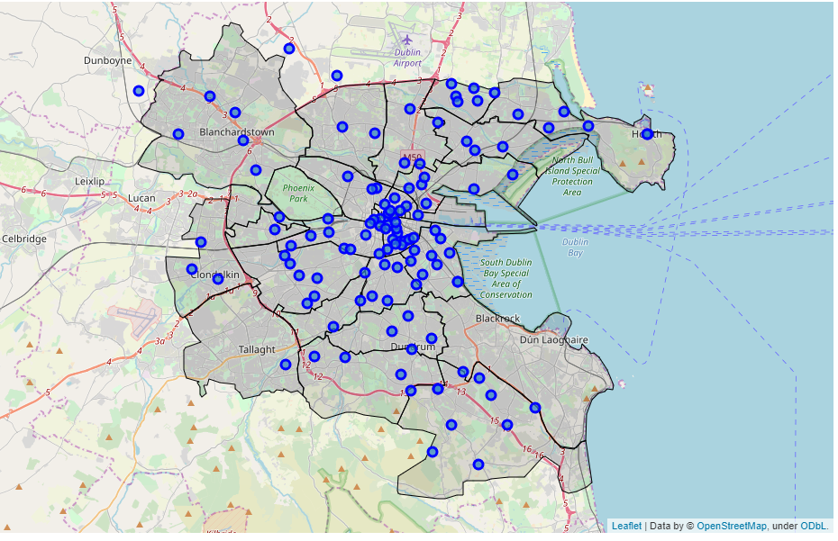
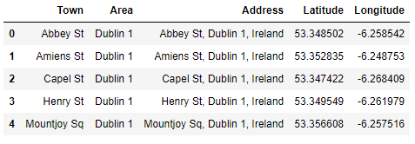
Visualizing Data
Mapping 120 Dublin towns in 20 postalcode areas

Slide 5
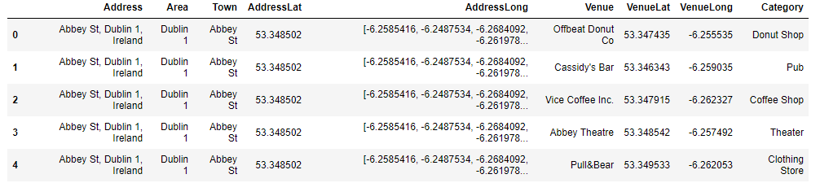
Foursquare API Call
The longitude and latitude of each town was searched in Foursquare and returns the venues near that location. A radius of 700m and a limit of 200 venues per location was used to limit the search. 3988 venue results were returned.
There are over 220 venue category values. Each of the postcode are then grouped by catagory as the catagory is the feature we care about most.

Slide 6
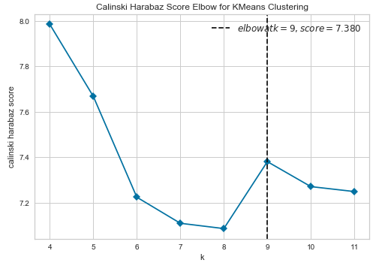
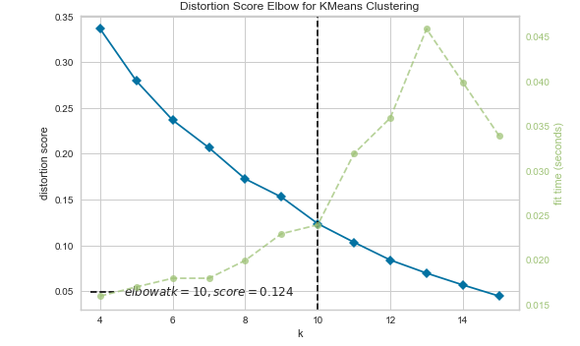
Using K-means to cluster Dublin

Slide 7
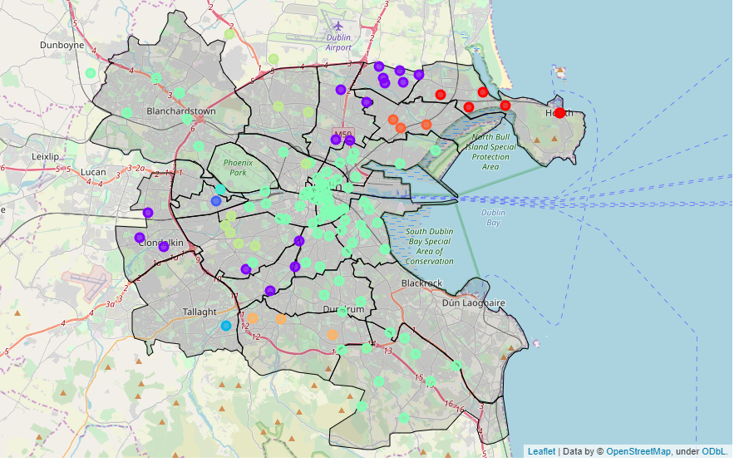
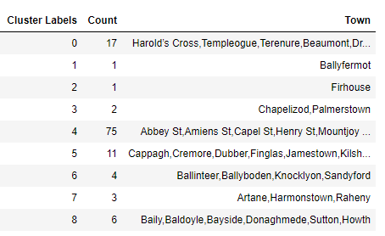
Results – 9 Clusters

Slide 8
Conclusion & Future Extensions
There is a massively disproportionate amount of towns seen in cluster 4. The 75 towns in this cluster are shown in light Turquoise on the map above.
Most of these towns are within the centre of Dublin city. With a lot of retail venues such as shops and shopping centres and a large number of food venues.
It is also seen that this large cluster seems to have two arms, reaching out to the areas of Blanchardstown in the NW of the map, and out to Dundrum in the SE of the map.
The two largest shopping centres in Dublin are located in Blanchardstown and in Dundrum.
Perhaps an extention to this project is to use this clustered data to build a desicion treee classifier. This could beused to recommend certain areas, based on what type of facilities and venues are in that area.

